Slide 1
Installation Instructions for Mac

Slide 2
Installing Anaconda

Slide 3
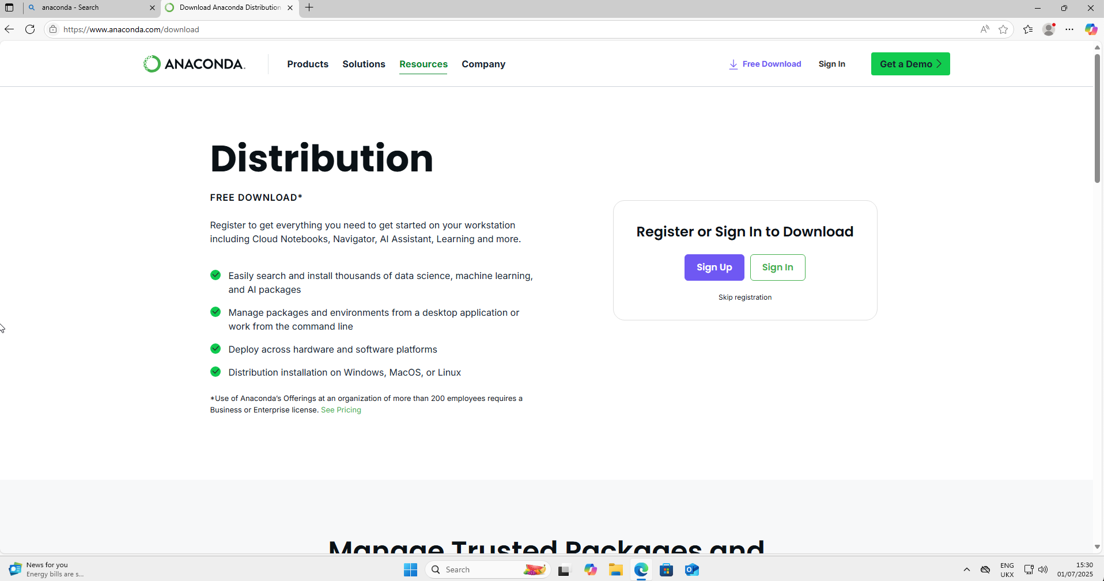
Go to https://anaconda/com/download

Slide 4
Click on ”Skip Registration” (as shown by the arrow)

Slide 5
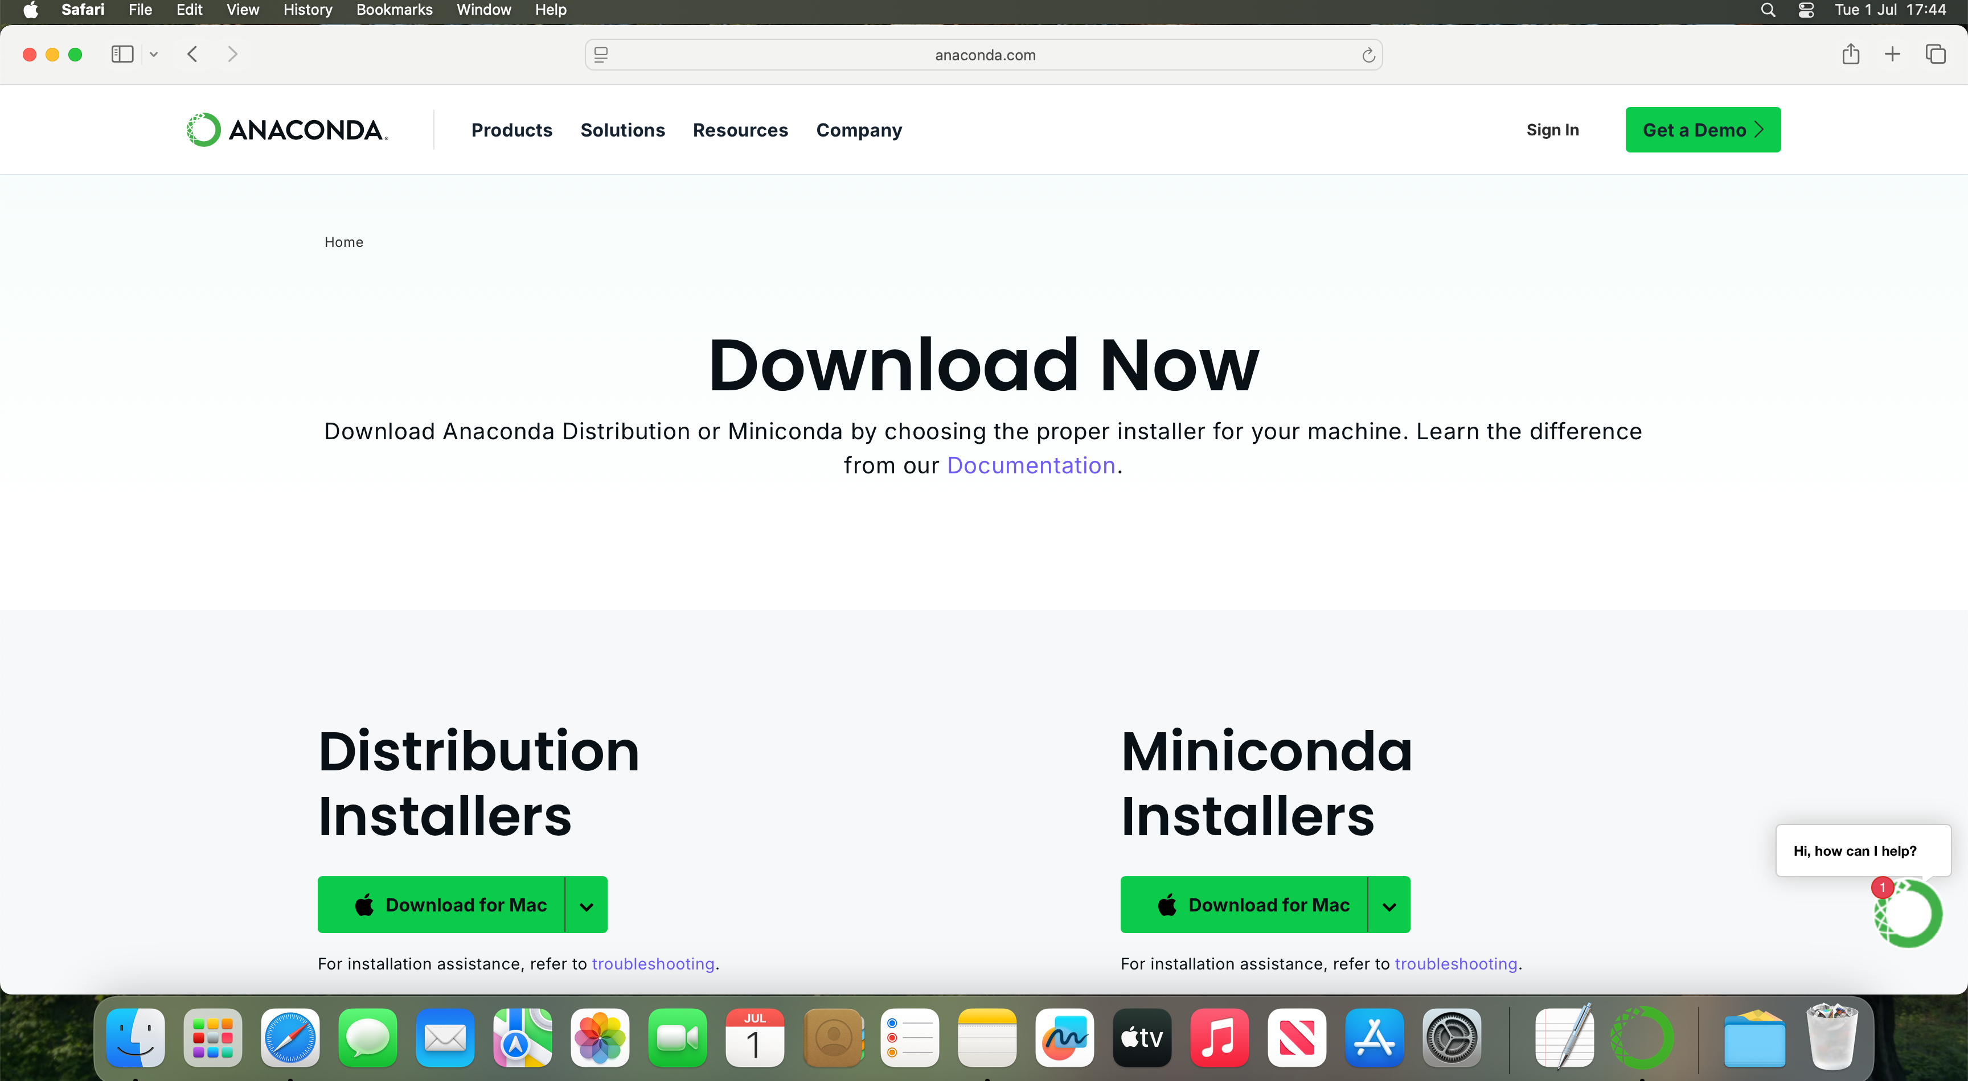
Your screen should now look like this
Click on “Download” on the left (where the arrow is pointing to)

Slide 6
You will be asked to download either Apple Silicon or Intel
If you have an M1, M2, M3 or M4 mac, choose Apple Silicon
If not, choose Intel
If you bought your Mac after 2021, it is very likely to be Apple Silicon
If it is older, choose Intel

Slide 7
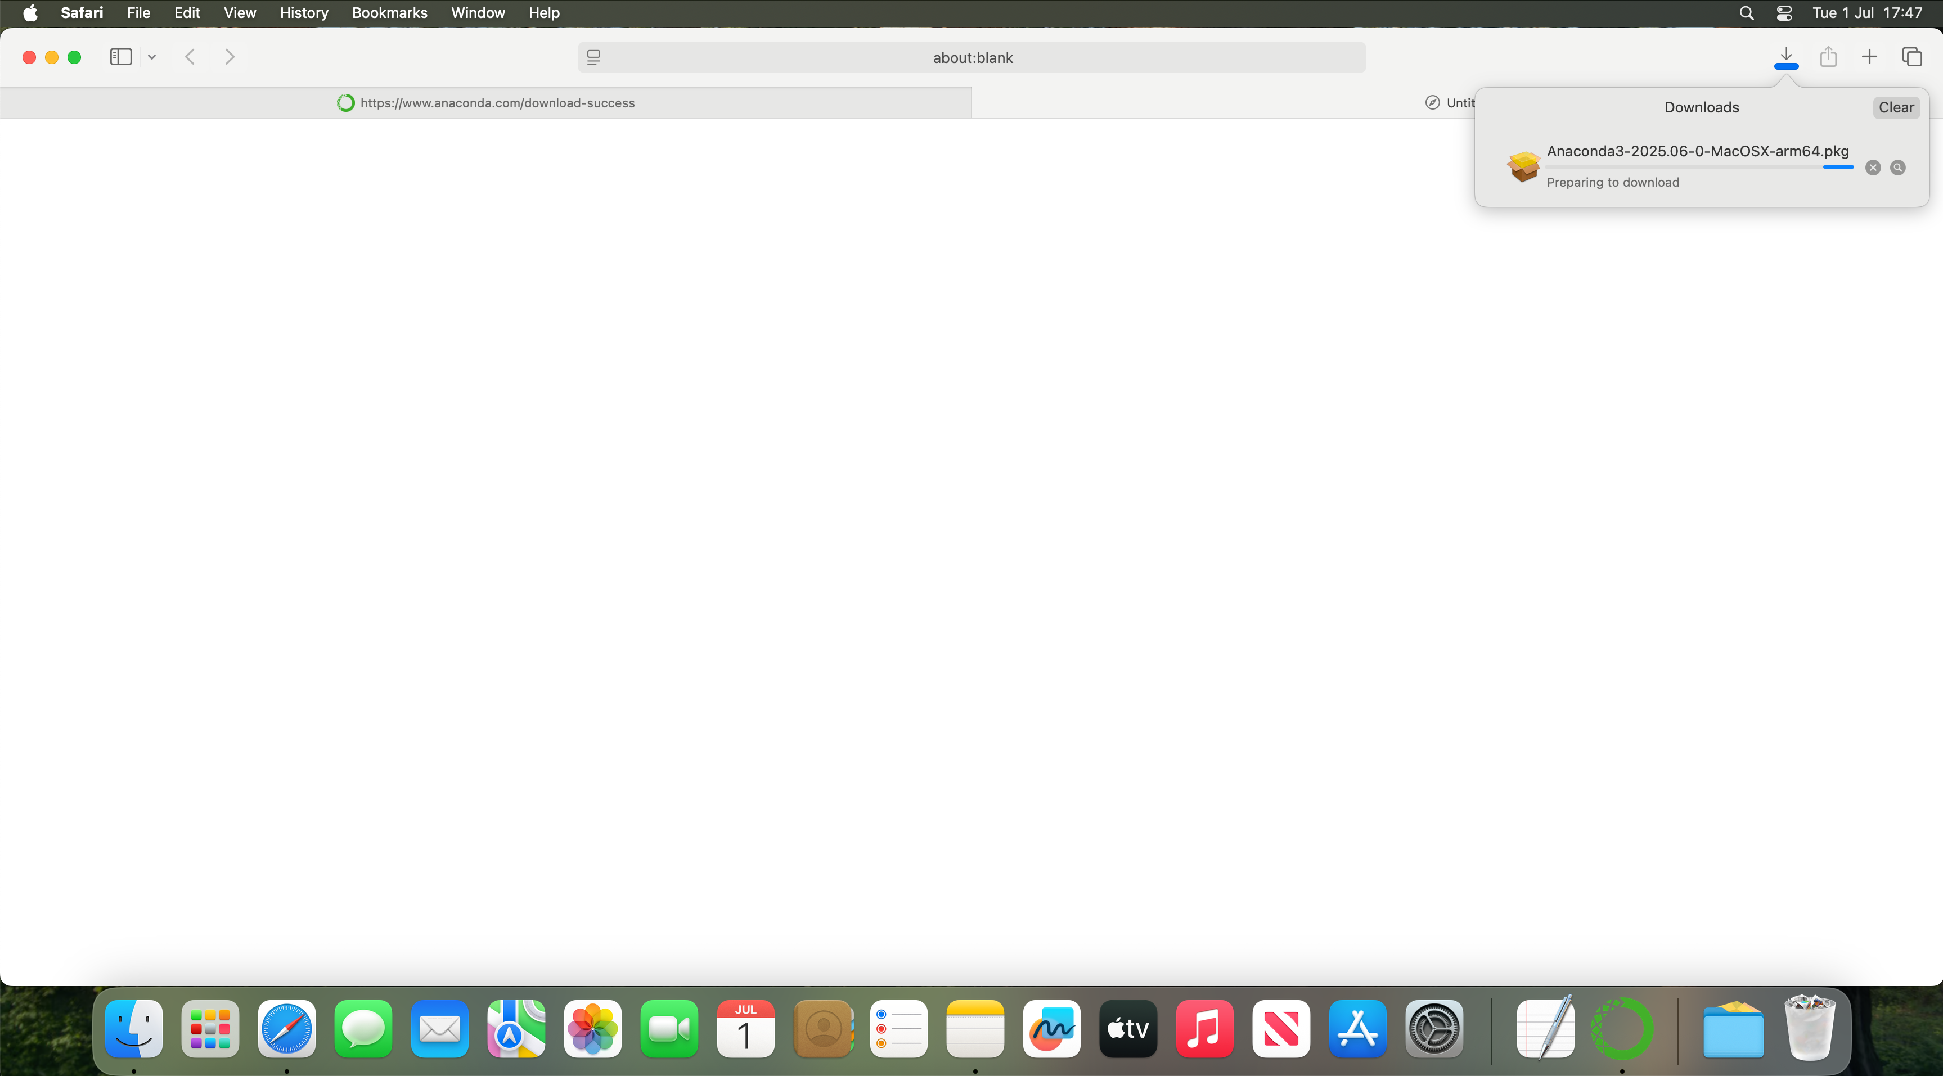
This will open up a dialogue box
You may be asked whether to “allow downloads on this site”. If you are, choose to Allow

Slide 8
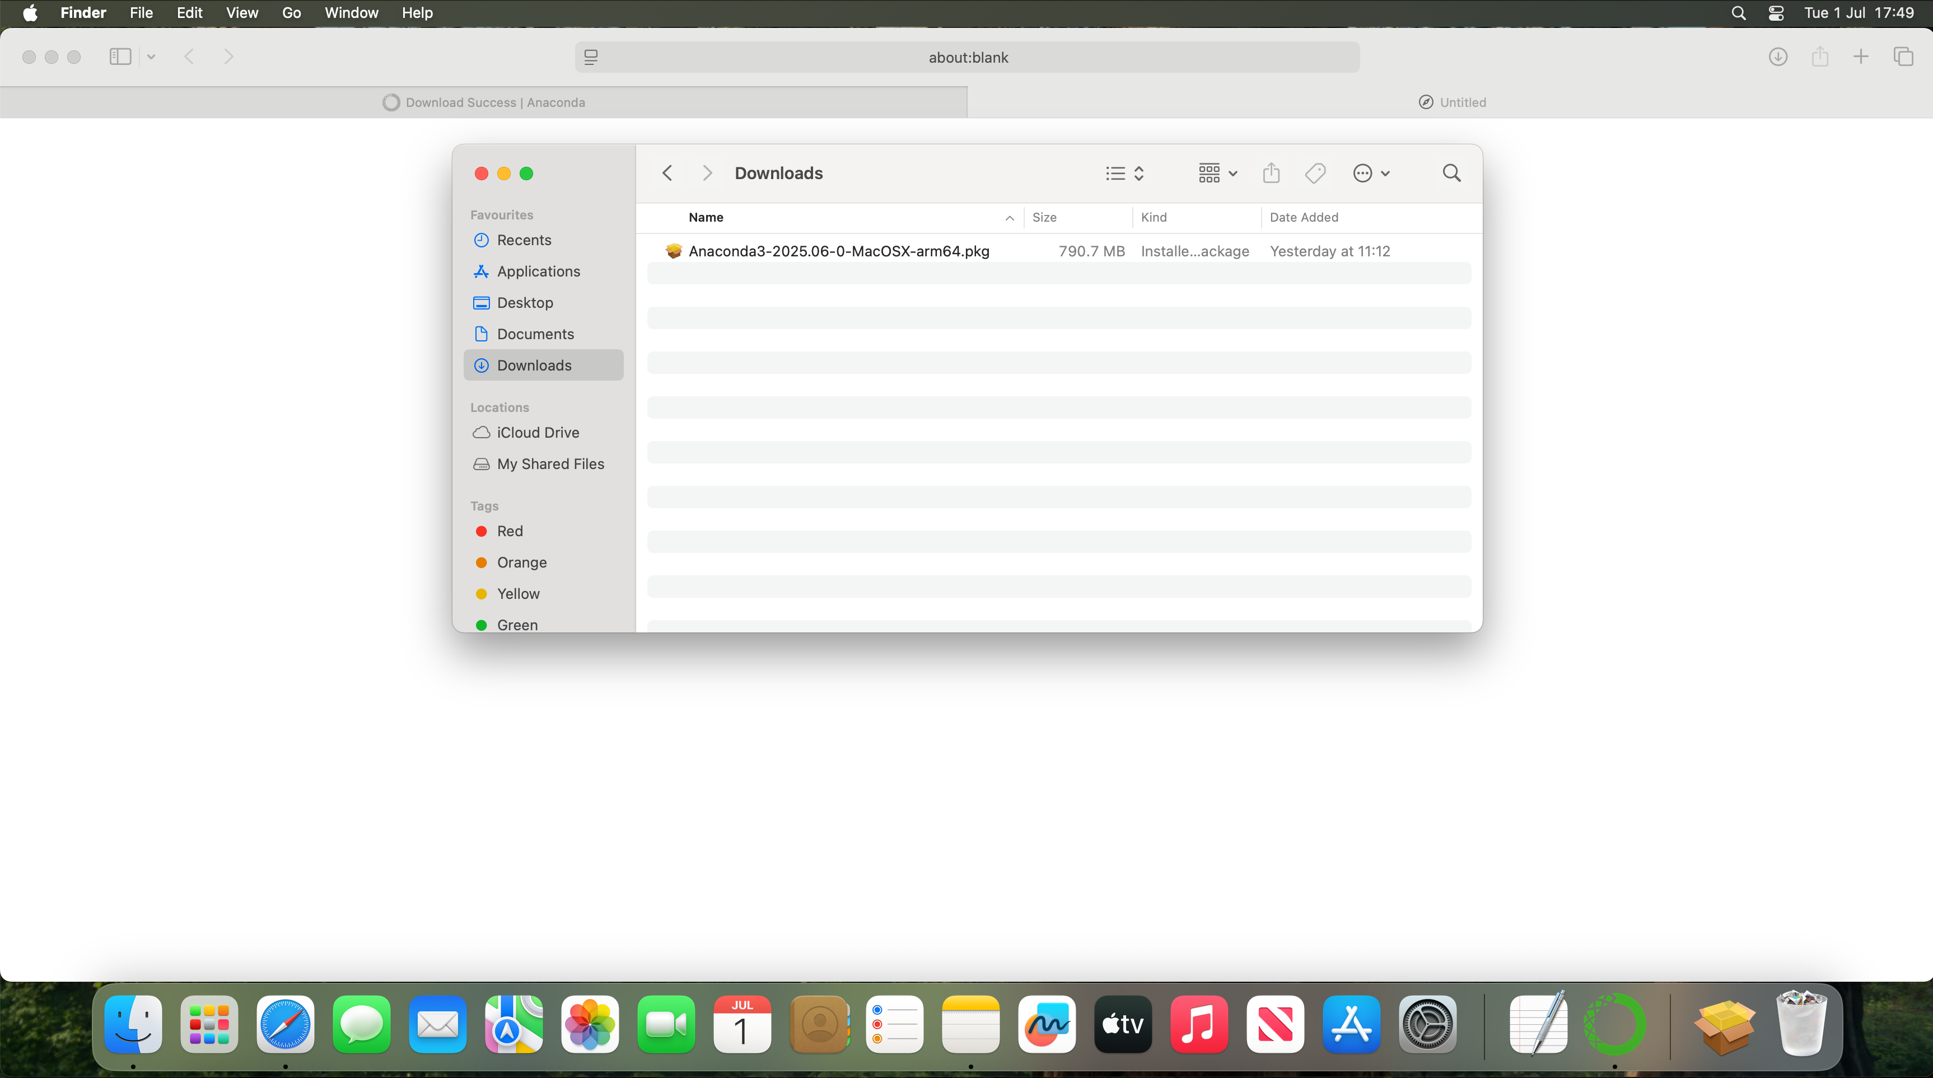
Open “Finder” and look for your Downloads folder

Slide 9
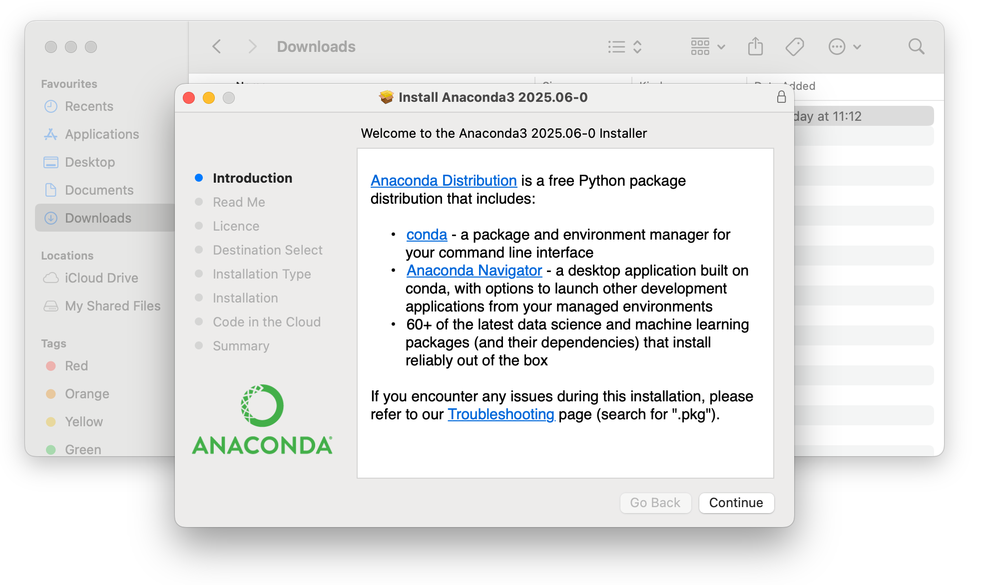
Open the new “.pkg” file that you have downloaded
It will open a dialogue box that looks like this:
Click continue

Slide 10
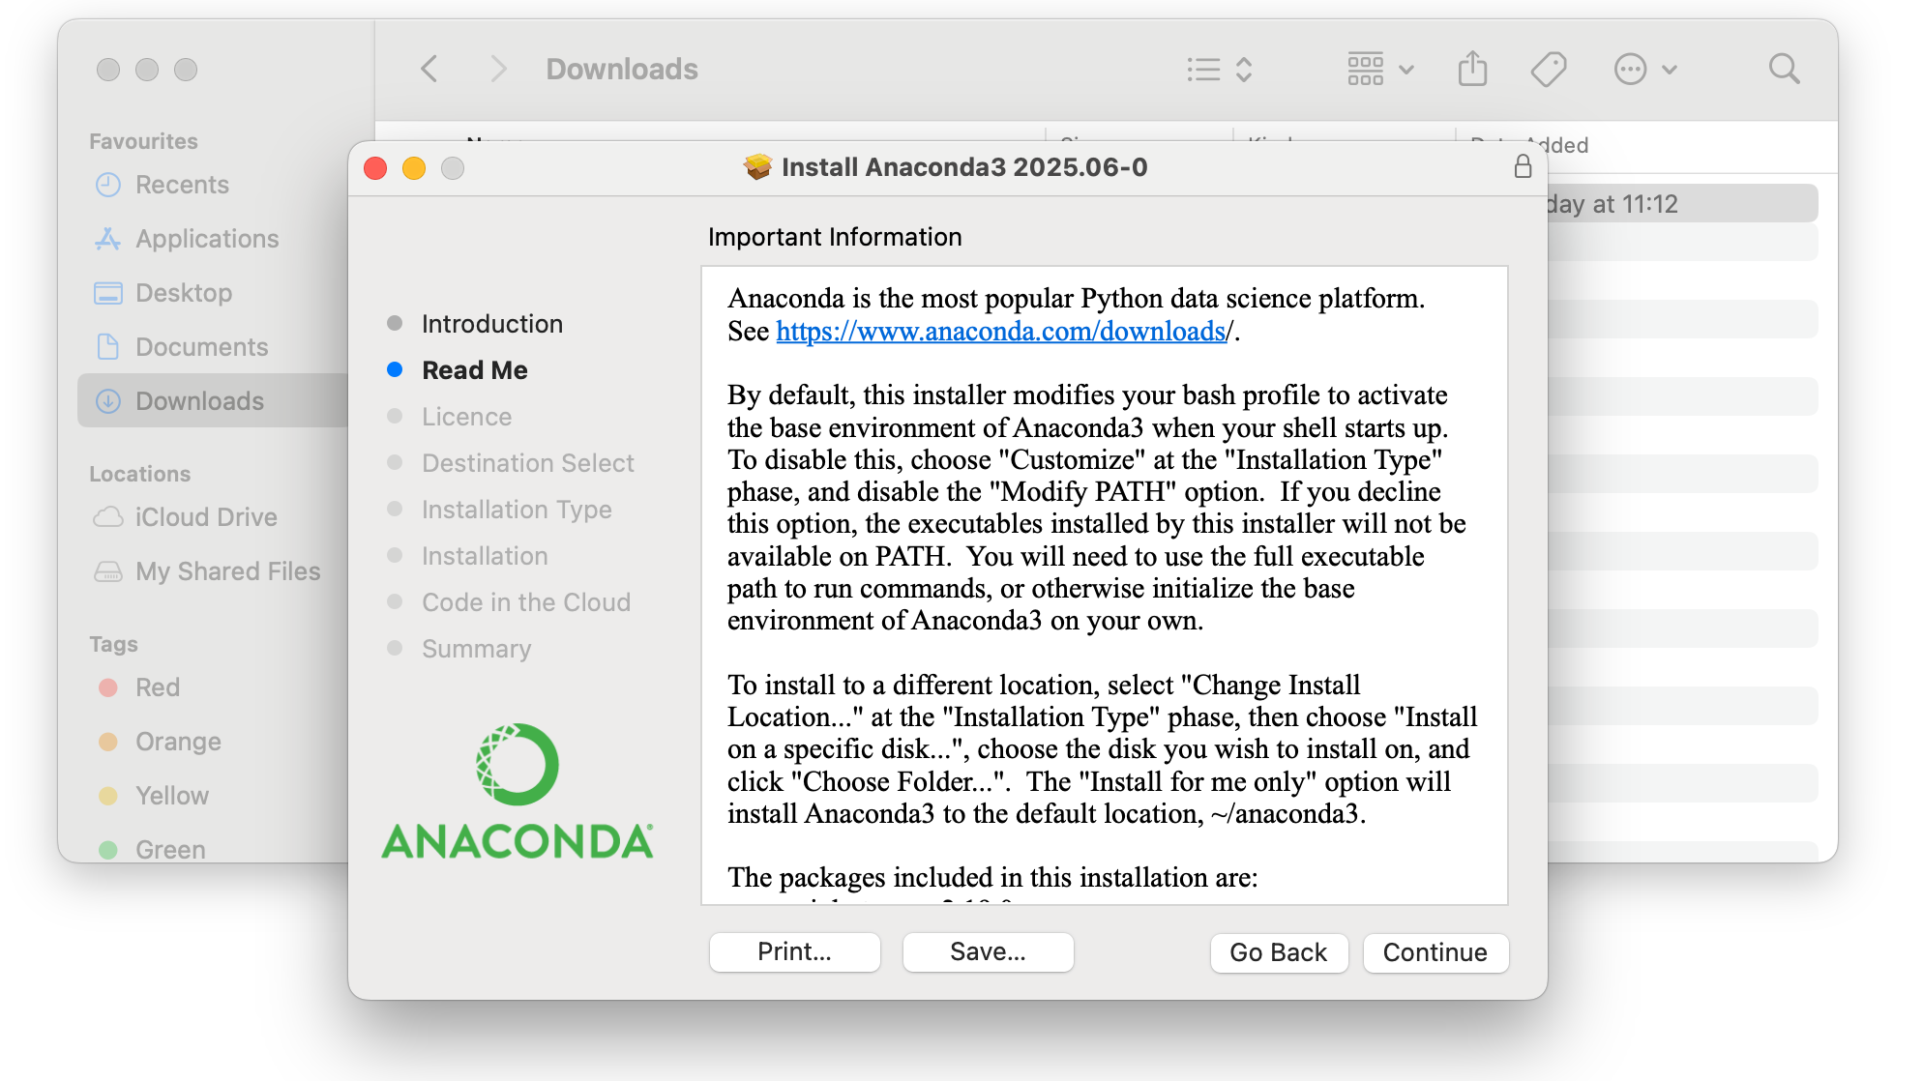
The next box will explain what you are installing
Click continue

Slide 11
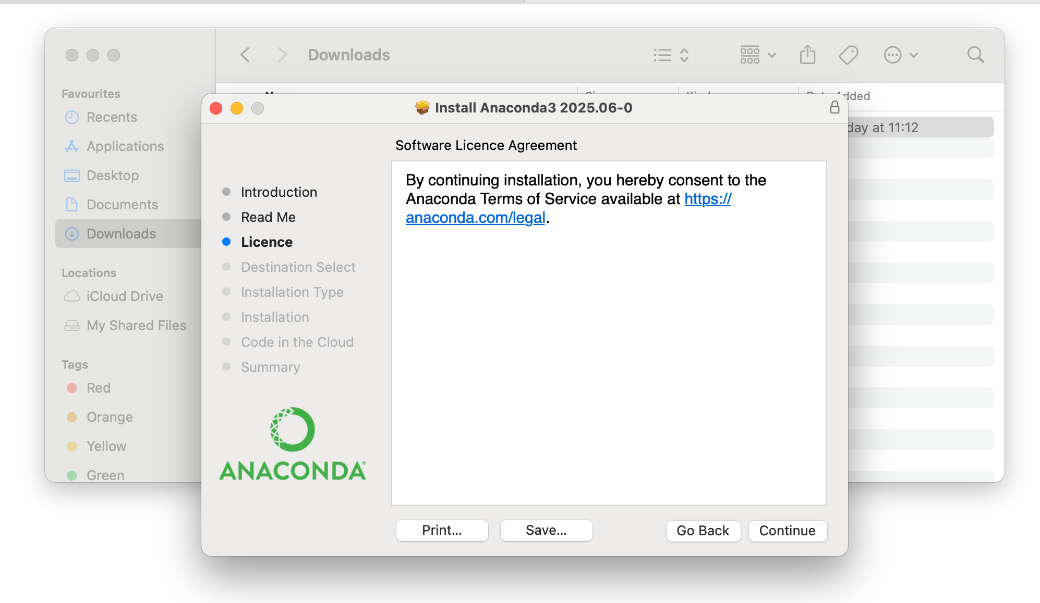
The next box will ask you to agree to the license agreement
Click continue

Slide 12
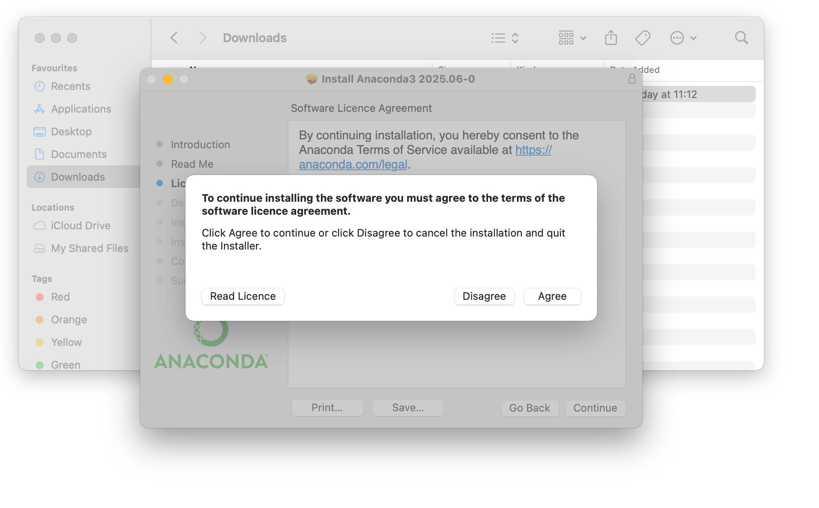
Click agree

Slide 13
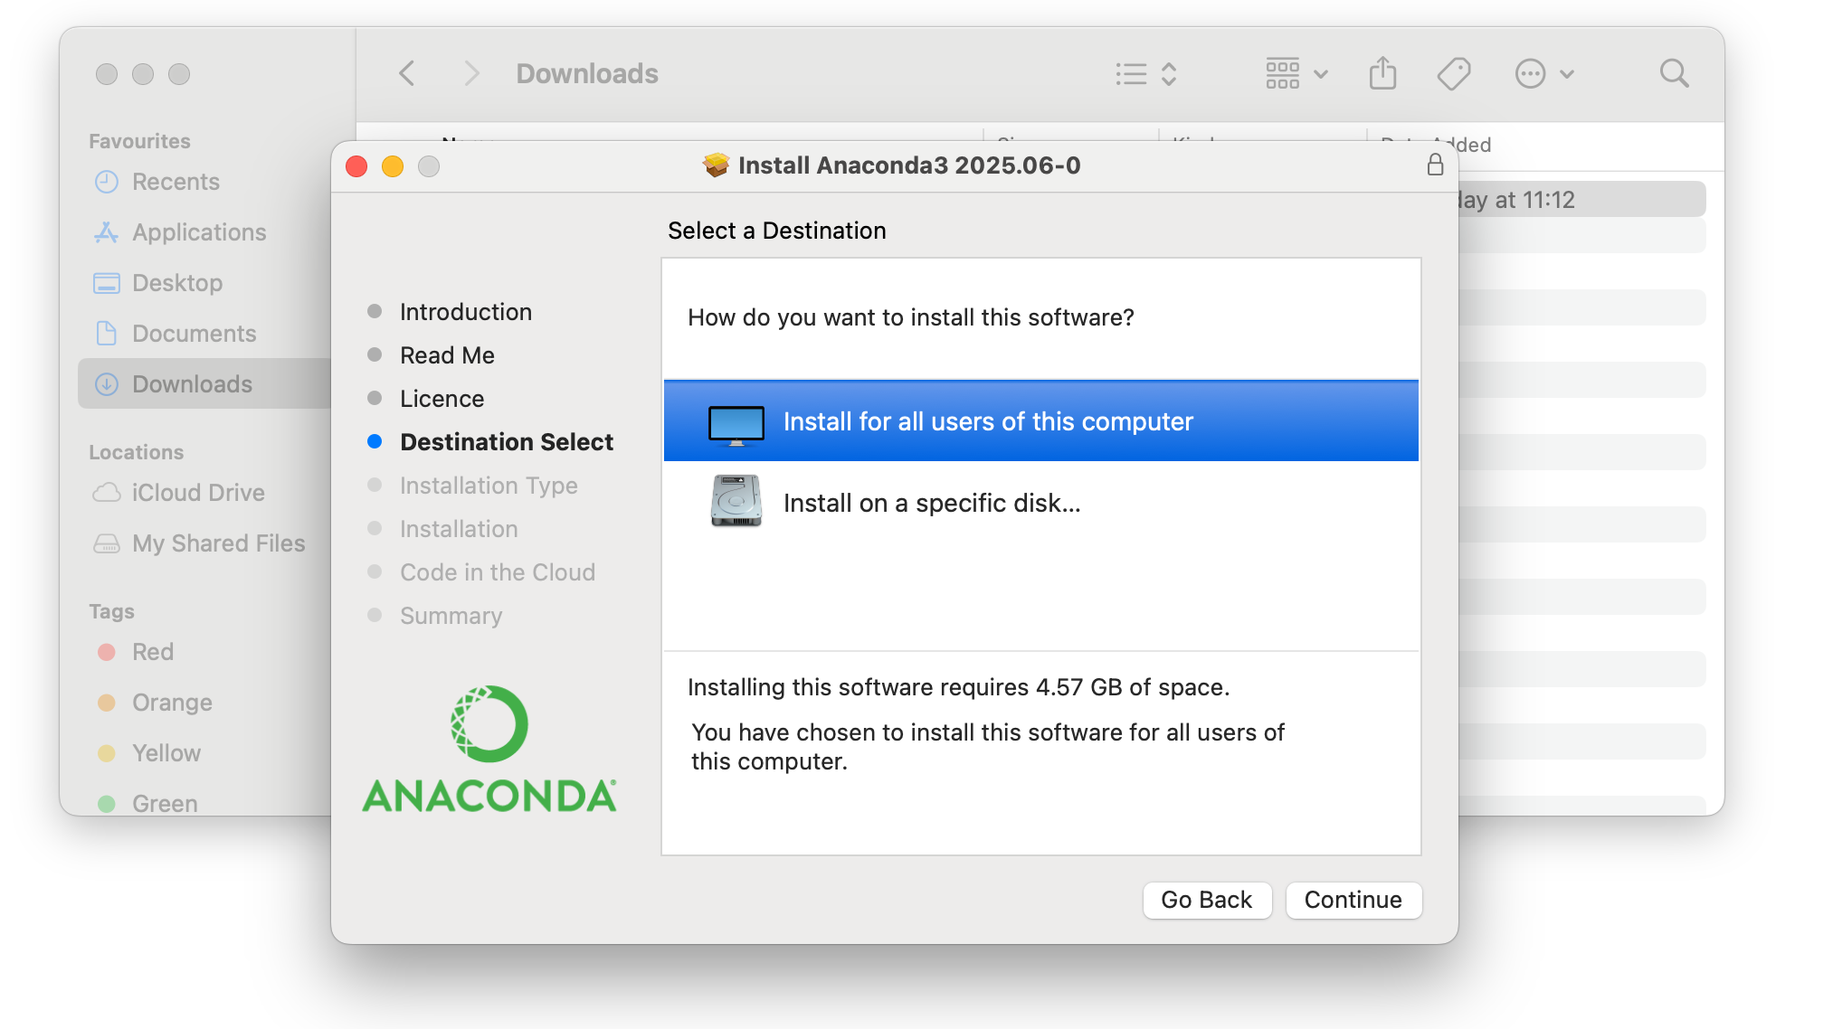
Click “Install for all users of this computer”
Then click “Continue”

Slide 14
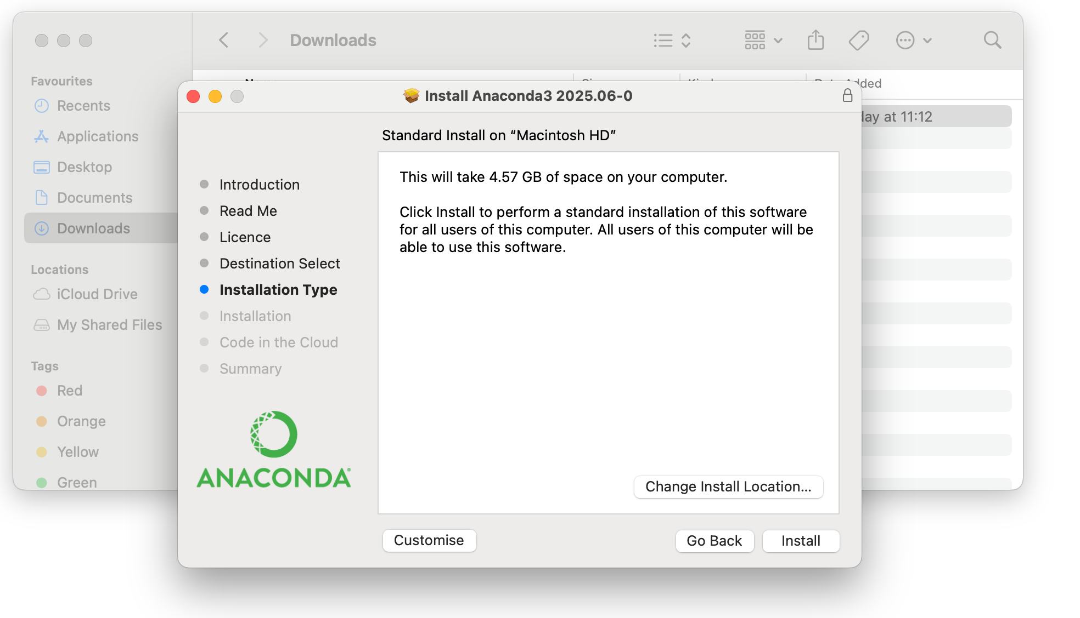
Click install

Slide 15
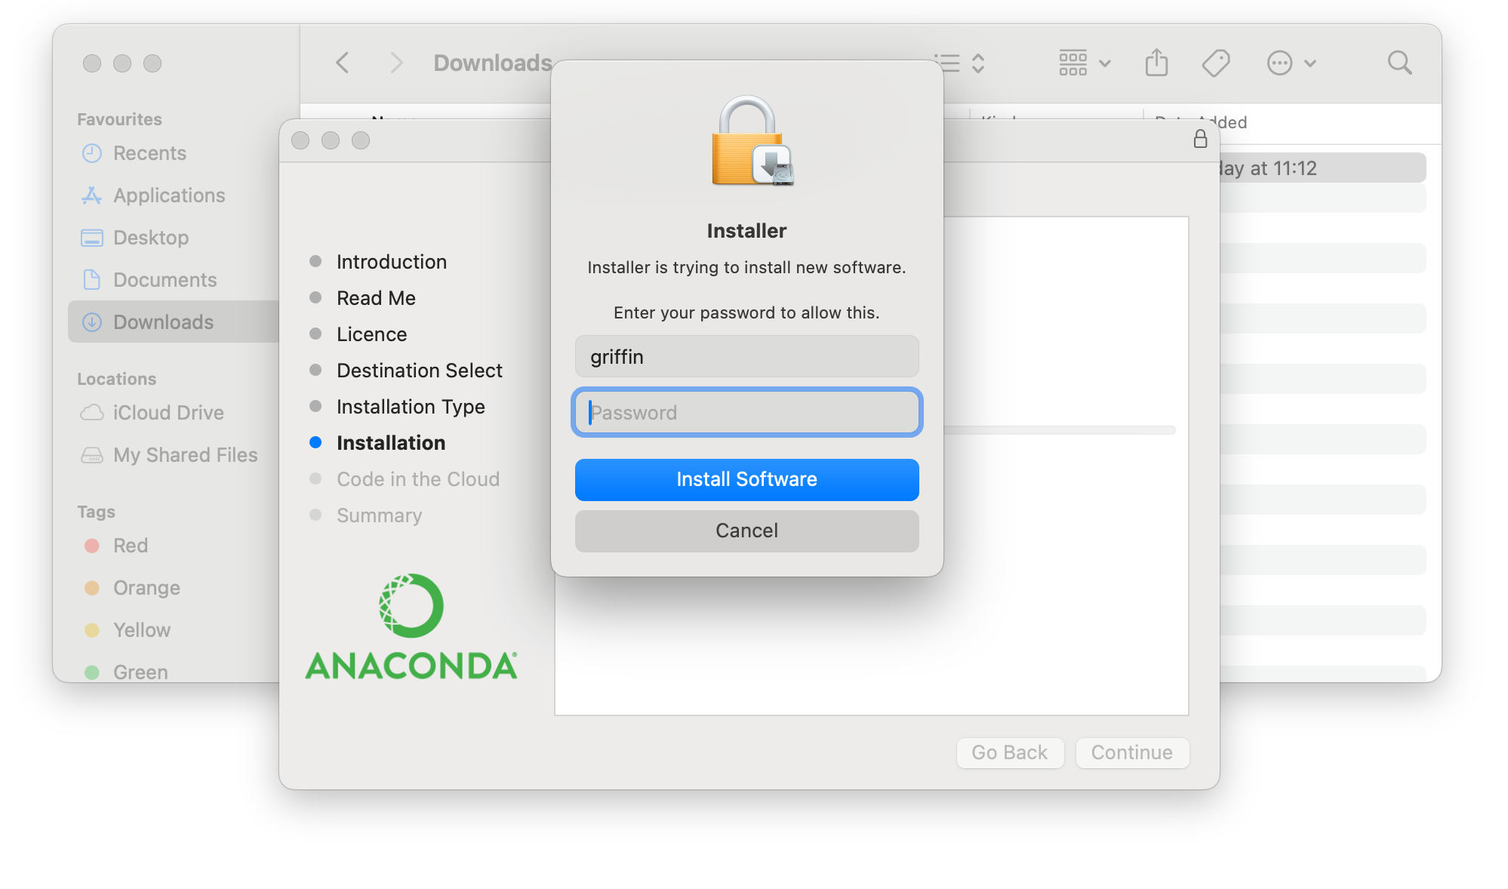
You will be asked to provide your password
Provide your password and click install software
The installation will start and a progress bar will show

Slide 16
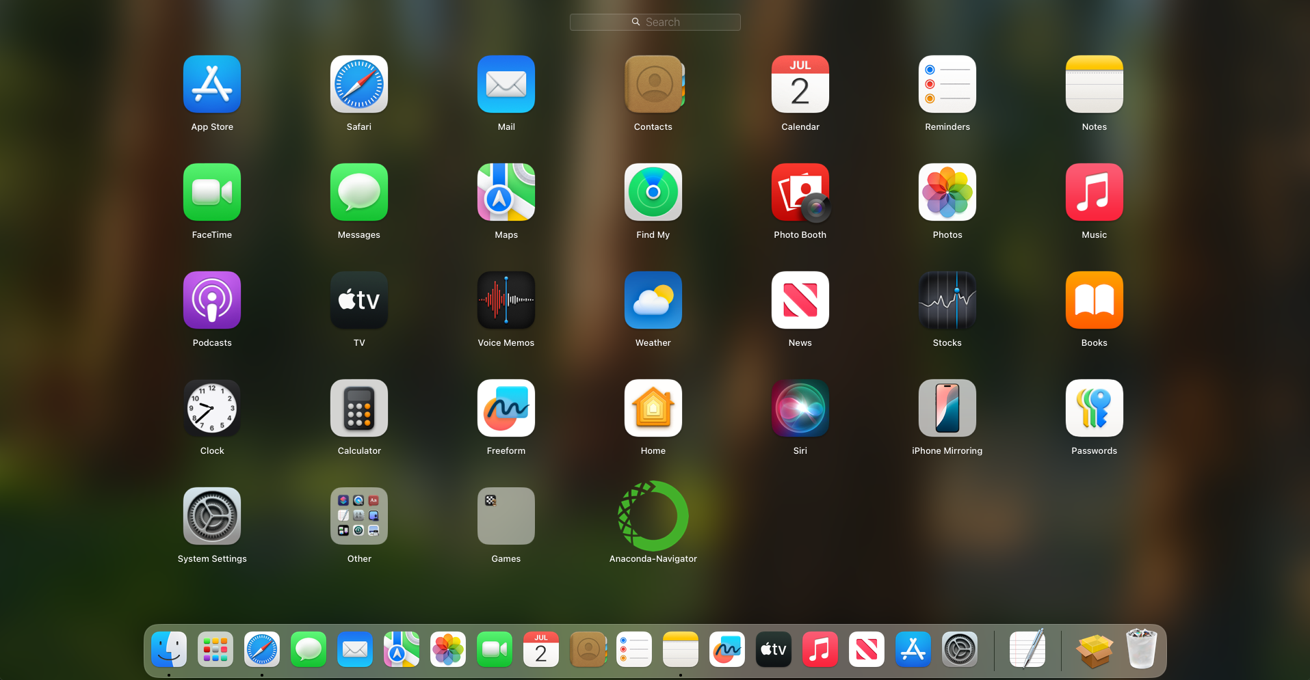
After the installation has finished, you should now have a program called “Anaconda Navigator” on “Launchpad” on your Mac
Click on it

Slide 17
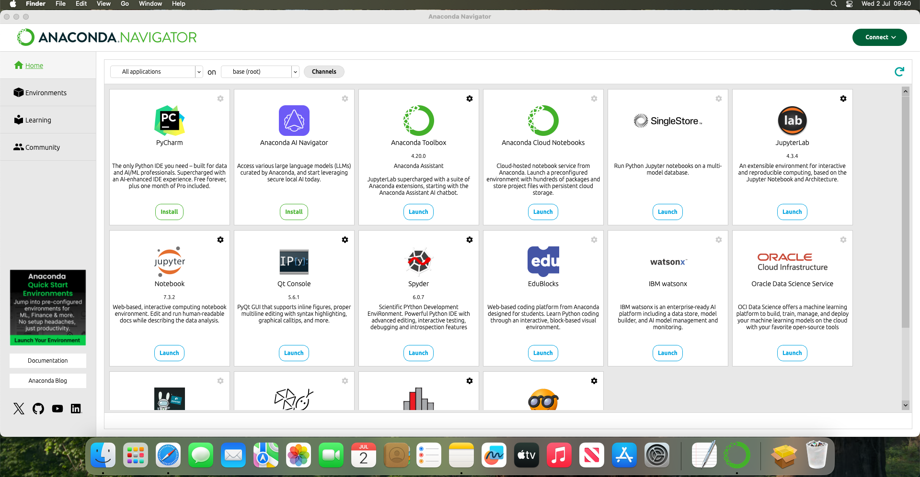
After about 30 seconds, a window like this will open
If you are waiting longer than a minute, try again
If this still does not work, you need to go back to the start of these instructions and follow them from the start

Slide 18
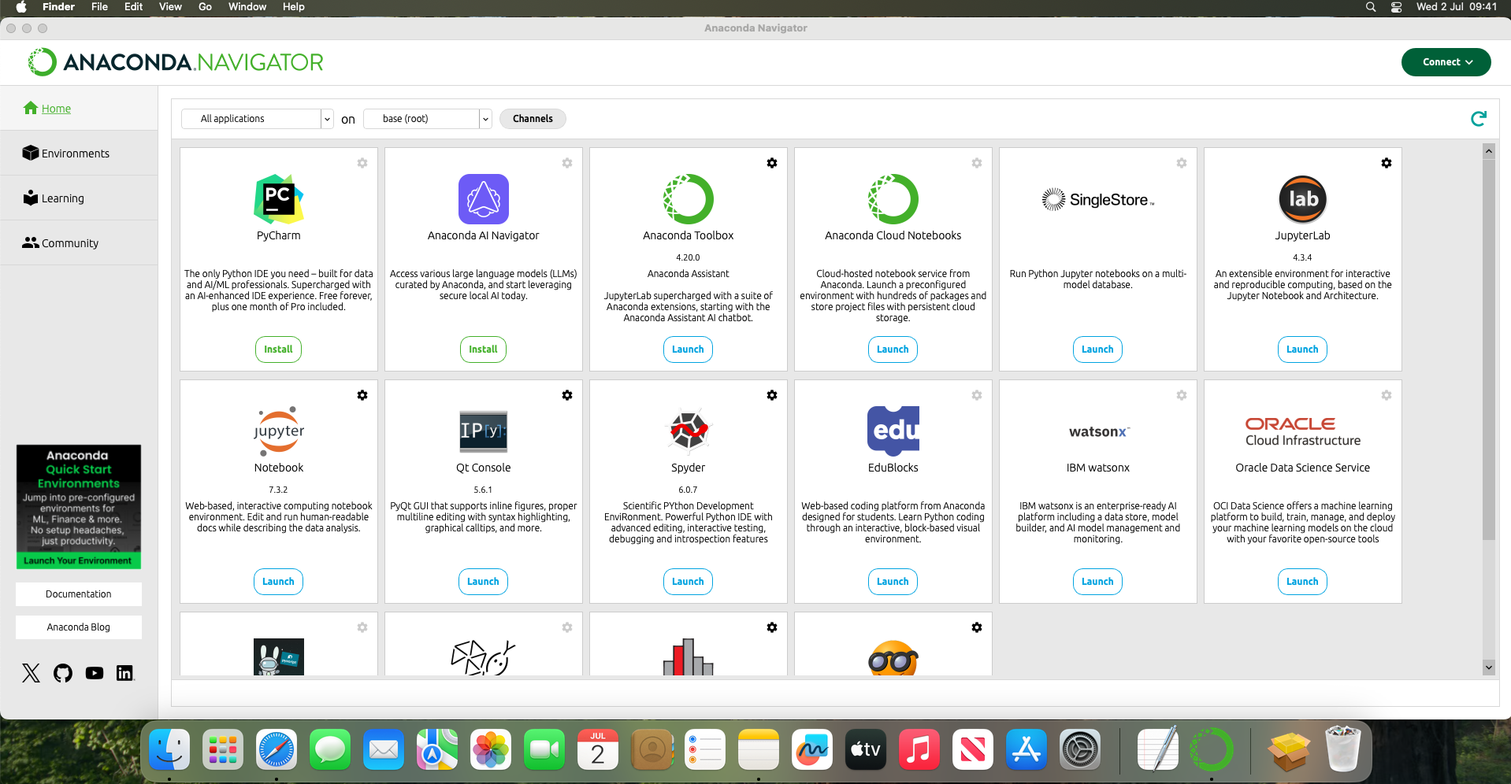
Find, and click “Launch” on “JupyterLab”
It has a black and orange logo

Slide 19
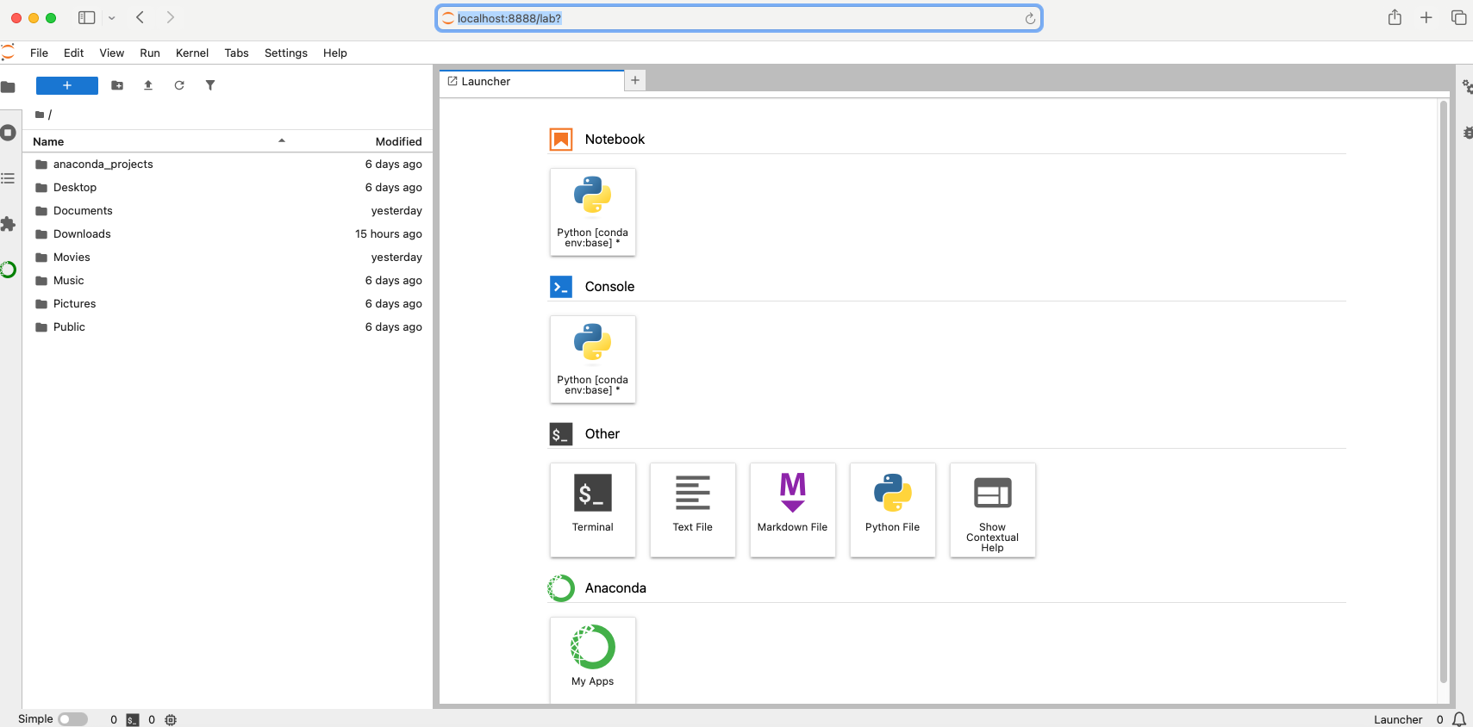
This will open up a new window in your browser
It should look like this

Slide 20
If this window does not open, then go back to the start of the installation instructions and follow them again

Slide 21
Downloading Course Materials

Slide 22
Open your browser and go to this URL: https://github.com/griffinfarrow/OXCEP-Precision-Dental-Medicine (for the dentistry course) or https://github.com/griffinfarrow/OXCEP-Precision-Medicine (for the medicine course)

Slide 23
github.com/griffinfarrow/OXCEP-Precision-Medicine
https://tinyurl.com/ye22a98r

Slide 24
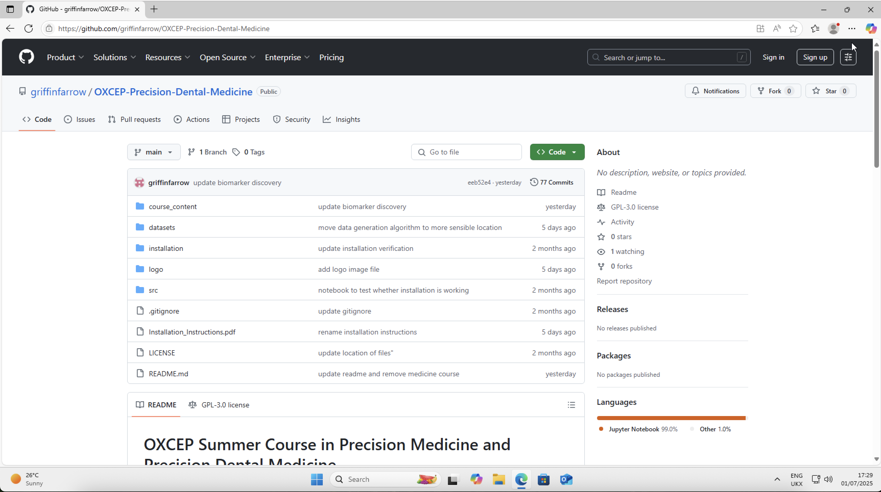
You should see a window like this:

Slide 25
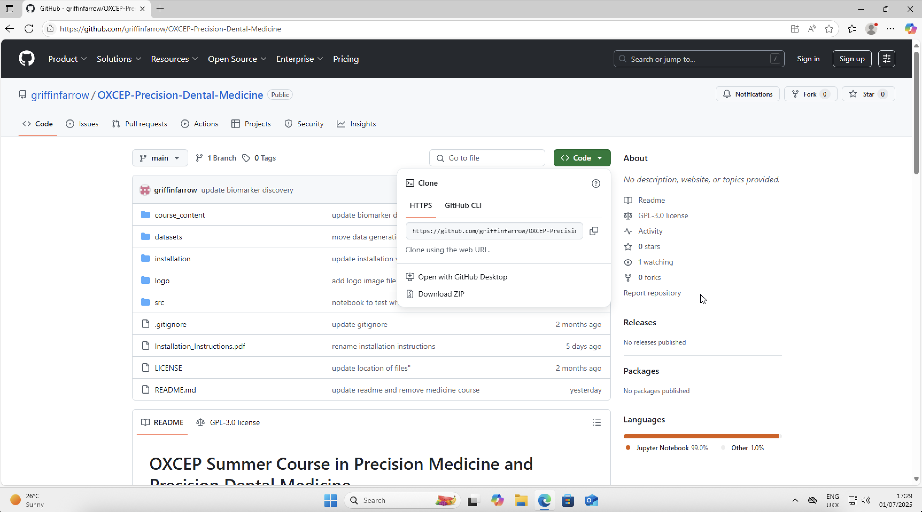
Go to the green “Code” button on the right hand side
Select “Download Zip”

Slide 26
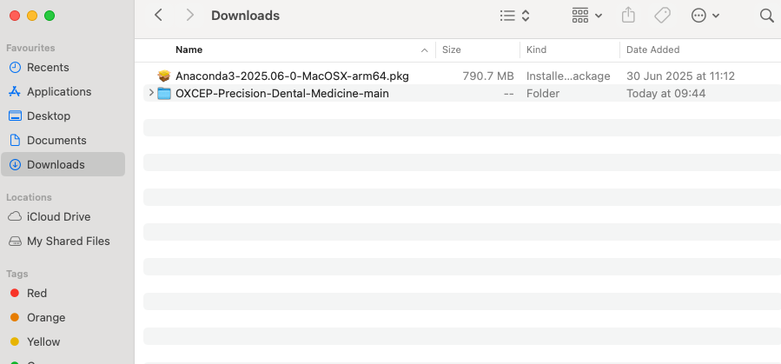
Once the Download has completed, go to your Downloads folder in Finder
You should see the file that you have downloaded

Slide 27
Congratulations! You have finished the installation for the course

Slide 28
Loading JupyterLab

Slide 29
Open the “Anaconda Navigator” from the Start Menu
Click “Launch” on JupyterLab
You should see a window like the next slide
If you are stuck, slides 17-25 showed how to open JupyterLab

